Slide 1


Fuzzy Logic Based Obstacle Avoidance Robot
Hoàng Huy Hoàng – 16020131 – K61-Đ-A-CLC

Slide 2
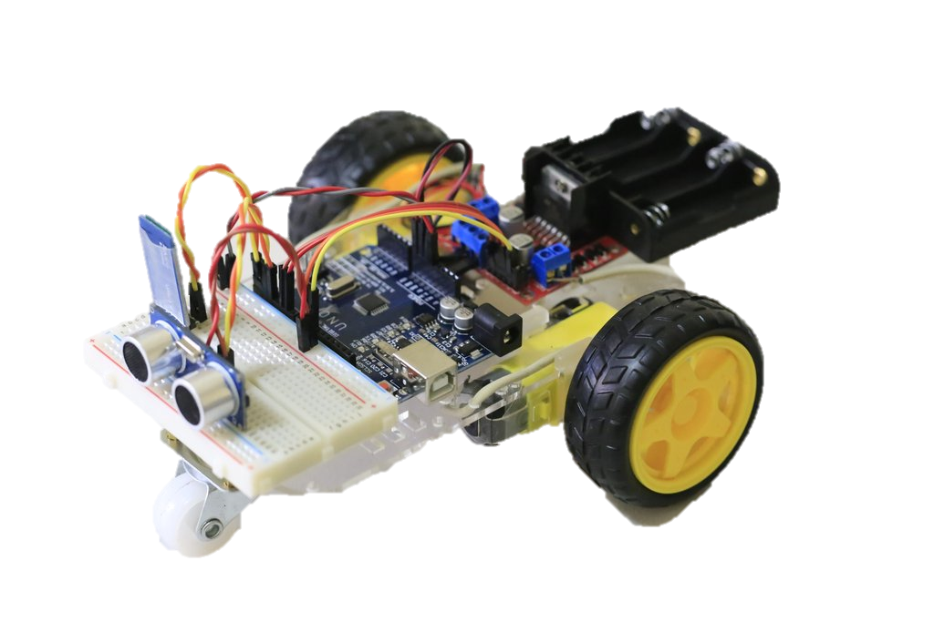
Summary
Introduction
Hardware
Fuzzy Logic
Conclusion

Slide 3
Introduction

Slide 4
Introduction
- An obstacle avoidance robot based on fuzzy logic.
- Use distance sensor in combination with fuzzy rules to make robot’s movement smooth.

Slide 5
Hardware

Slide 6
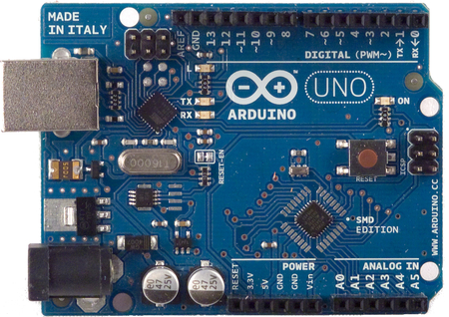
Hardware
Arduino Uno R3
CPU | Atmega328 – 8bit
Tần số | 16MHz
Điện áp | 5V DC
Dòng tiêu thụ | 30mA
Số chân | 14 chân digital, 6 chân analog
SRAM | 2KB
Flash | 32KB
EEPROM | 1KB

Slide 7
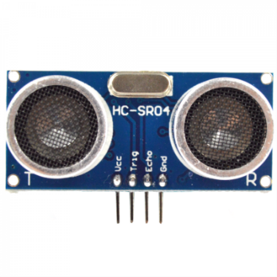
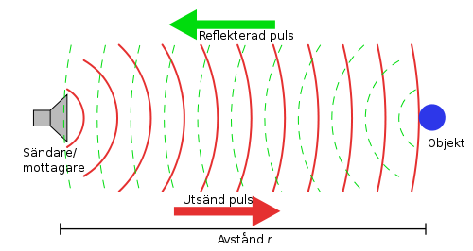
Hardware
HC-SR04
- Range: 2 – 300cm
- Principle:
Reflected waves
Transmitter
Object
Emitted waves

Slide 8
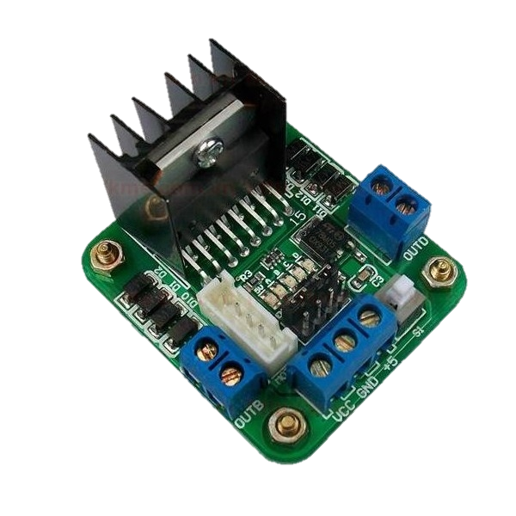
Hardware
Motor Driver L298
- H-bridge circuit.
- Allow control of speed and direction of 2 motors.

Slide 9
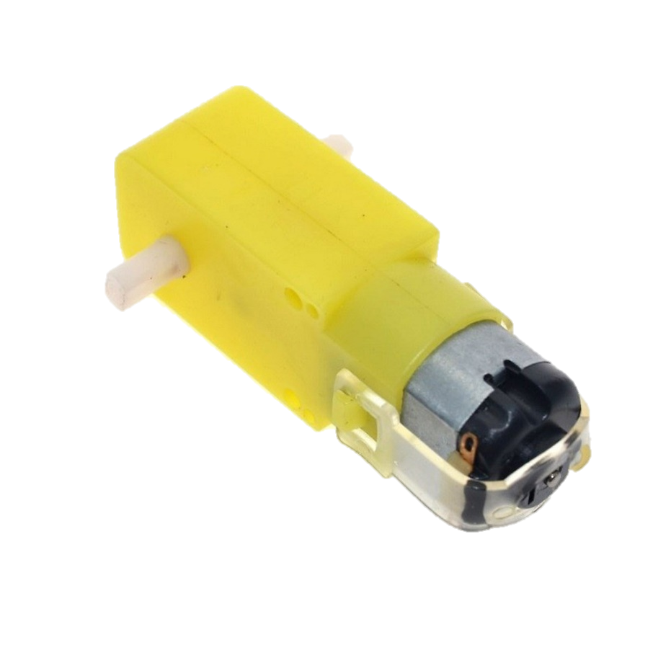
Hardware
Geared DC Motor
- Equipped with gear for extra torque.

Slide 10

Hardware
18650 Battery
- 18x65mm
- Rechargeable
- 3.7V – 4800mAh

Slide 11
Fuzzy Logic

Slide 12
Fuzzy Logic
Left distance sensor
Fuzzy logic rules
Left motor
Middle distance sensor
Right motor
Right distance sensor

Slide 13
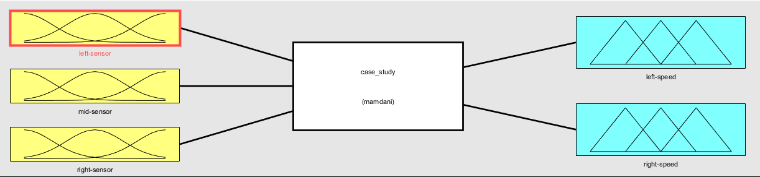
Fuzzy Logic
- 3 inputs and 2 outputs
- Mamdani rule
- Centroid defuzzification

Slide 14
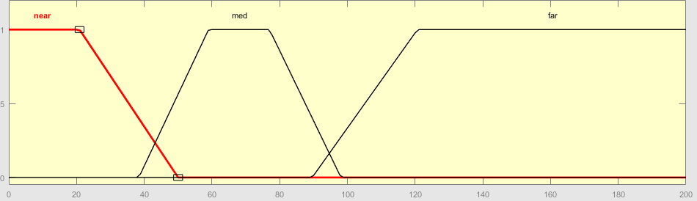
Fuzzy Logic
- Input membership function

Slide 15
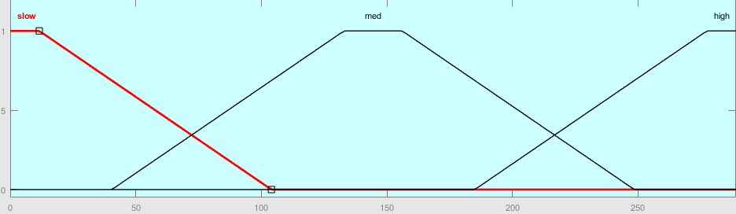
Fuzzy Logic
- Output membership function

Slide 16
Fuzzy Logic
-Fuzzy rules
Left sensor | Middle sensor | Right sensor | Left Motor | Right Motor
Near | - | - | Fast | Slow
- | - | Near | Slow | Fast
NOT Near | Medium | NOT Far | Slow | Medium
NOT Near | Medium | Far | Slow | Medium
NOT Far | Medium | NOT Near | Medium | Slow
Far | Medium | NOT Near | Medium | Slow
- | Near | - | Slow | Slow
Medium | - | - | Medium | Slow
- | - | Medium | Slow | Medium

Slide 17
Conclusion

Slide 18
Conclusion
- Robot is able to avoid obstacles by applying fuzzy logic.
- Robot speed changes flexibly corresponding to distance to obstacles.
- Combine input from 3 sensors to control robot’s movement.

Slide 19
Conclusion
- Unable to move backward.
- No use of feedback mechanisms (i.e encoder).

Slide 20
QUESTION
& ANSWER

Slide 21
THANK YOU FOR LISTENING !

